Slide 1
Royalties Analysis

Slide 2
Context
The board has raised concerns about the lack of detailed insights into neighbouring rights royalties and how they have evolved over time. This is a critical area for the company, as it directly impacts the distribution of royalties to clients, territories, and works.
Purpose:
Track the growth of royalties over time
Identify where royalties are coming from
Highlight the top earning clients, tiers, and works
Pinpoint potential revenue loss due to suspicious accounts and deactivated works
Provide actionable recommendations

Slide 3
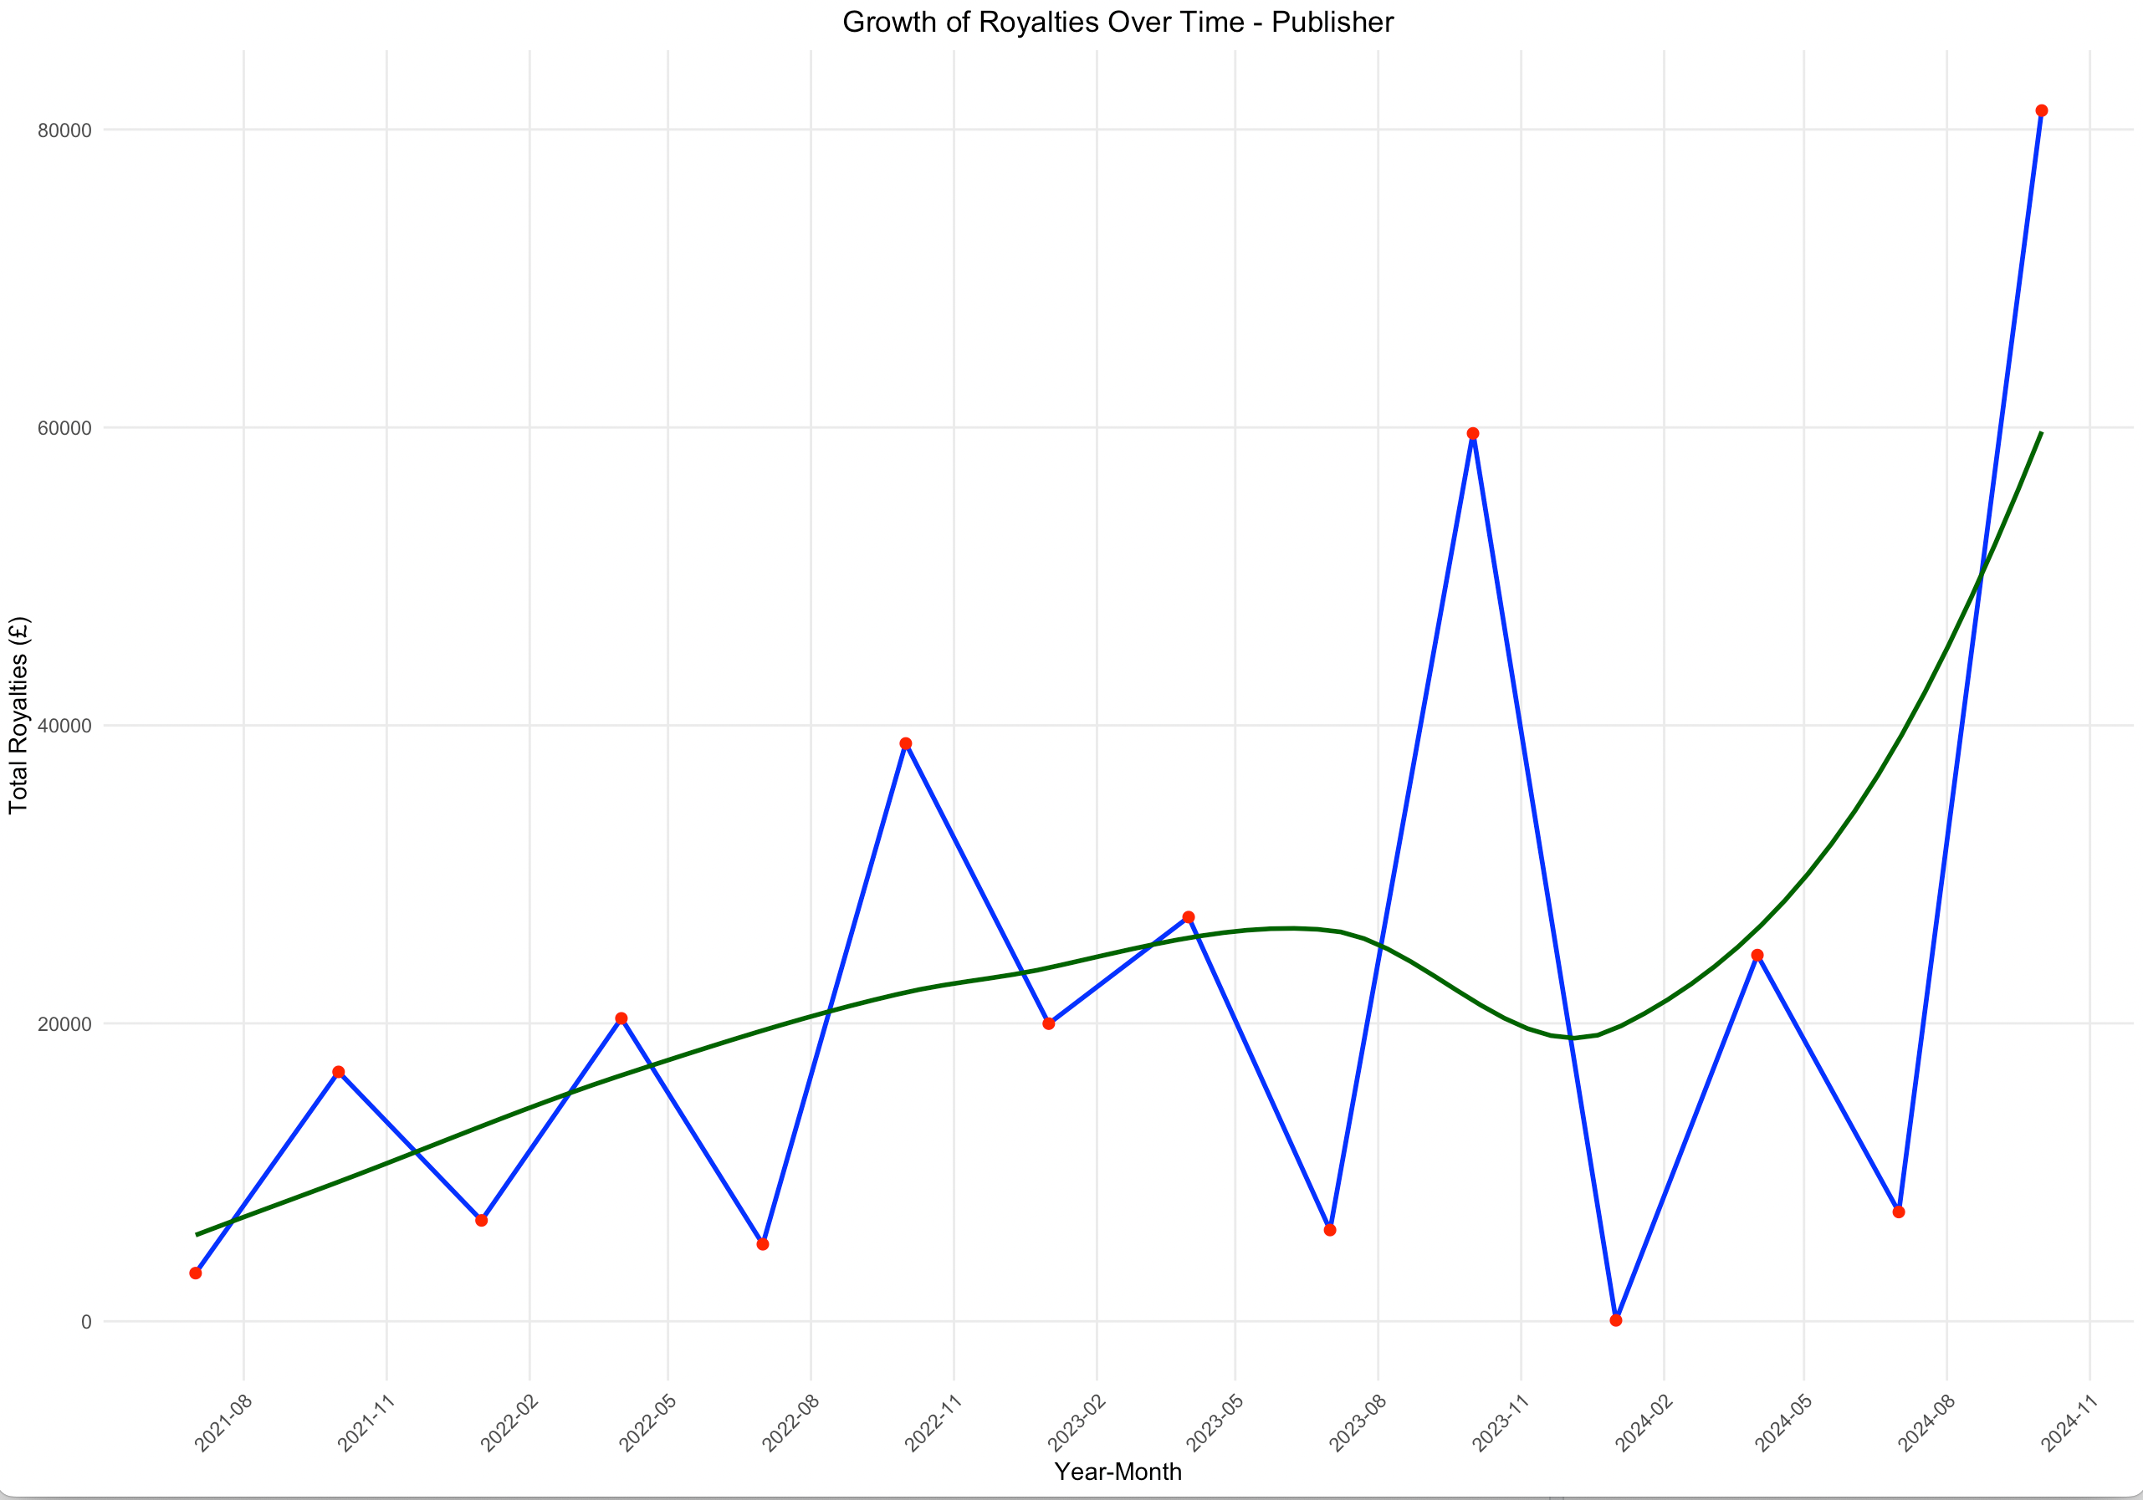
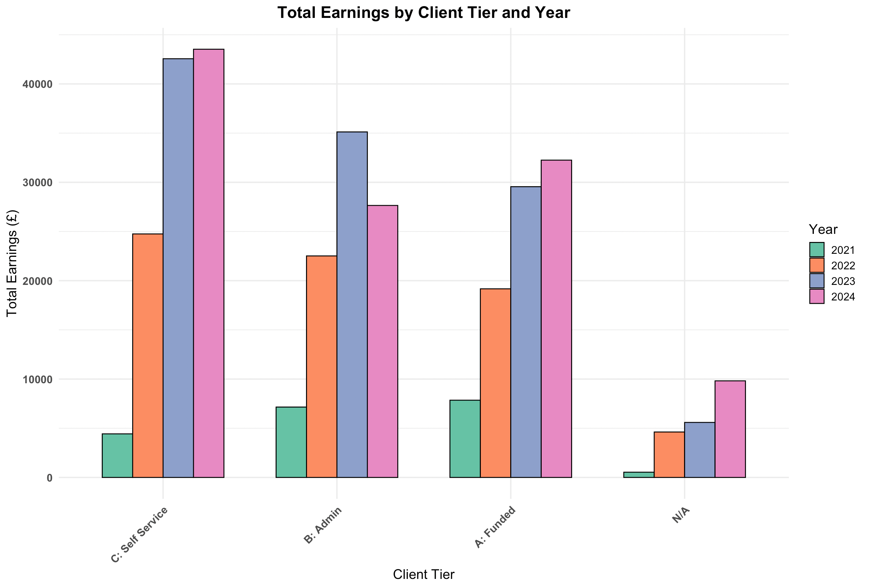
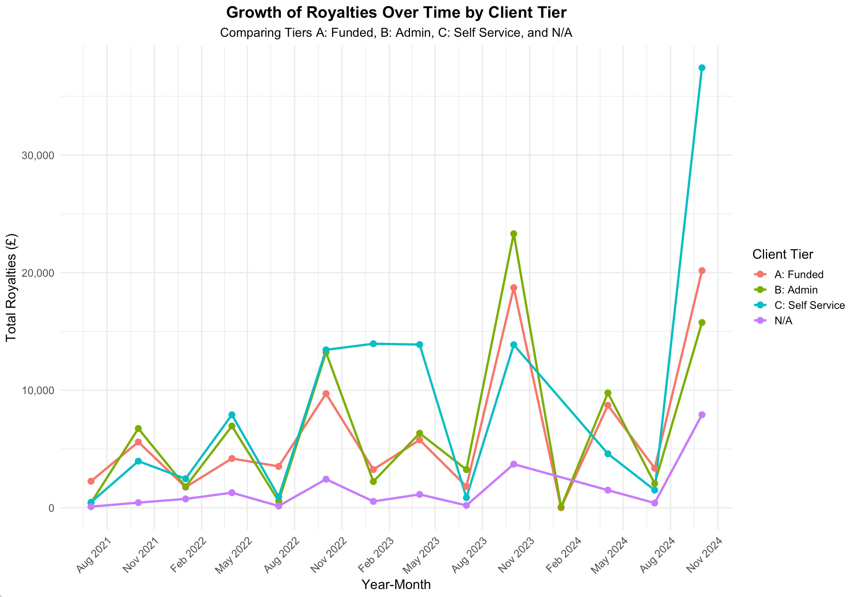
Growth Analysis
Insight: There is volatility in revenue over time, but client tiers, especially C: Self Service, are showing significant growth.
Insight: There is consistent growth over time, though with notable spikes and drops.
Recommendation:
Monitor growth patterns, especially in the Self-Service,
Adapt marketing and resource allocation strategies to accommodate this growth.
Investigate dips in revenue
Analyse and address dips
Adjusting marketing or outreach efforts during low periods.

Slide 4
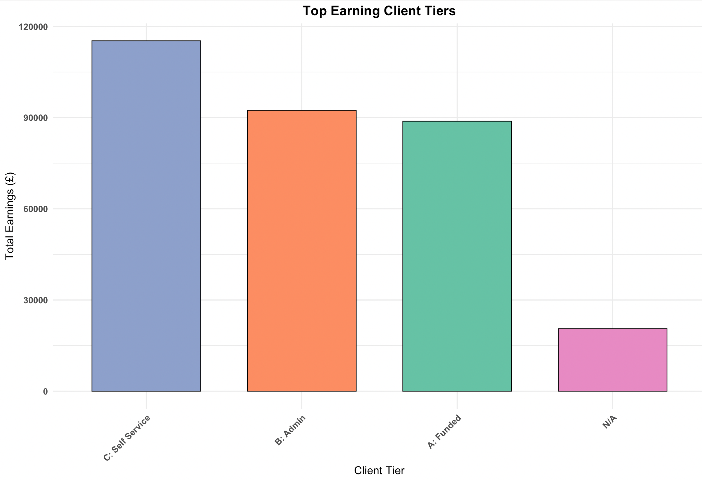
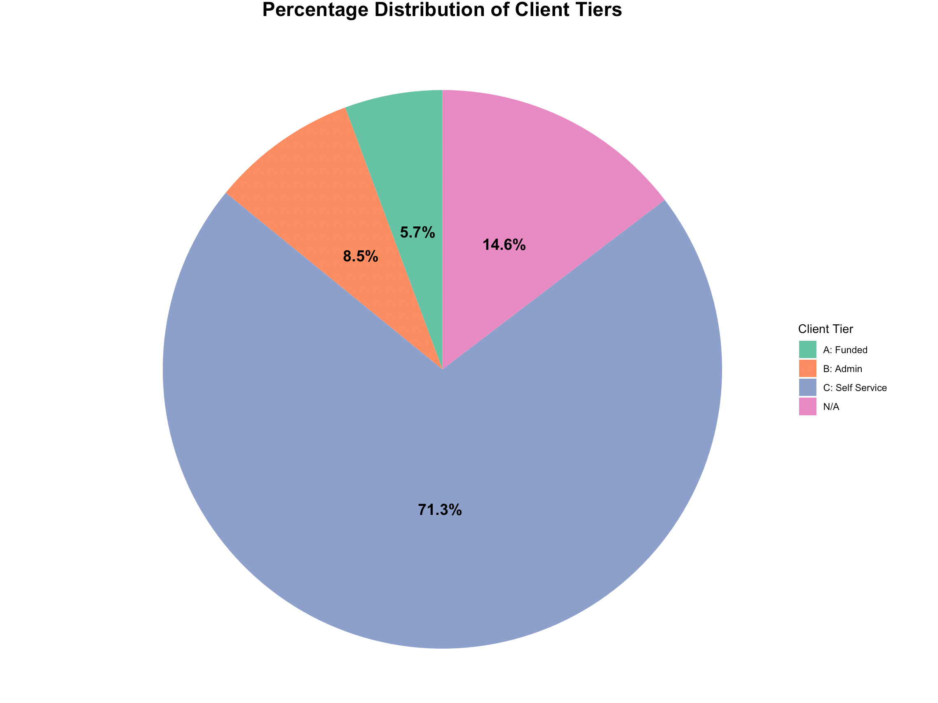
Client Tier Analysis
Insight: The Dominance of Self-Service Clients
Insight: High Earnings Potential Across Tiers
Self Service typically require less direct management but generate high volumes of royalties through self-managed processes.
Admin, despite their smaller numbers, bring in significant revenue, likely due to a more managed and personalized approach, optimized for higher-value clients.
Funded, while smaller in number and proportion, generate substantial revenue, suggesting that funded clients have higher individual contributions on average compared to the self-service tier.
Recommendation:
Further Invest in Self Service Client Support
Boost satisfaction, improve retention, and increase revenue.
Target Growth in the Admin and Funded Tiers
Exclusive services, enhanced reporting, or premium features could help attract and retain more clients
Balance Resource Allocation
balanced approach, investing in both self-service and support for high-tier clients, could maximize overall revenue

Slide 5
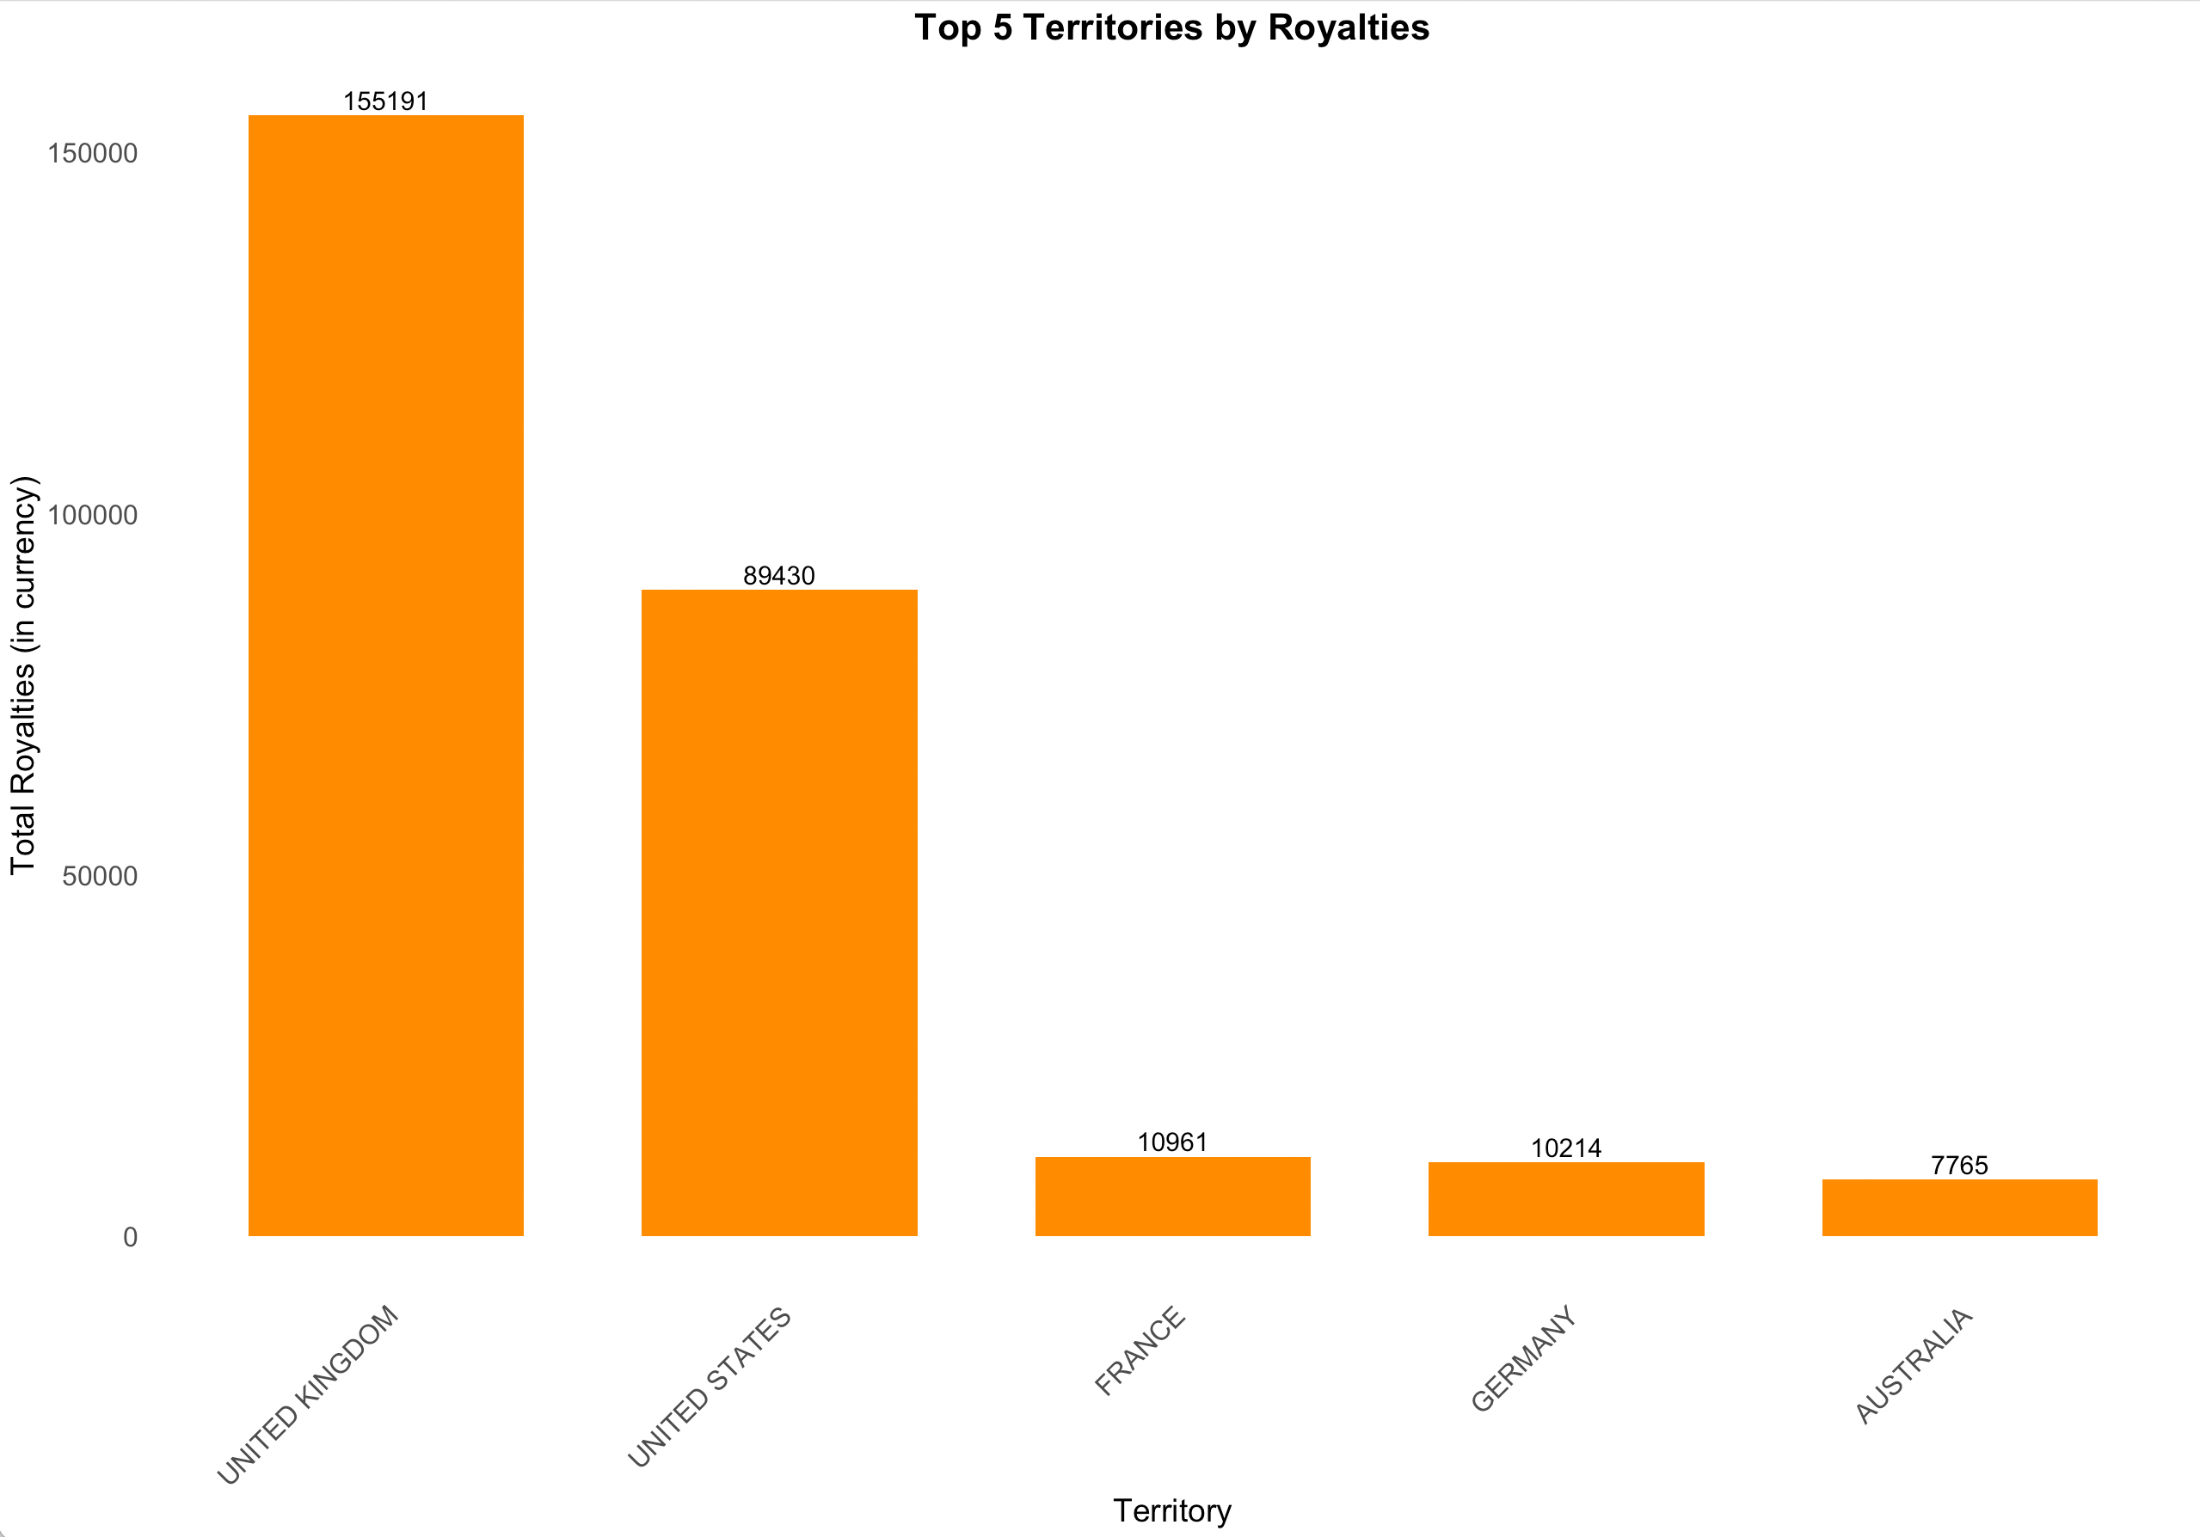
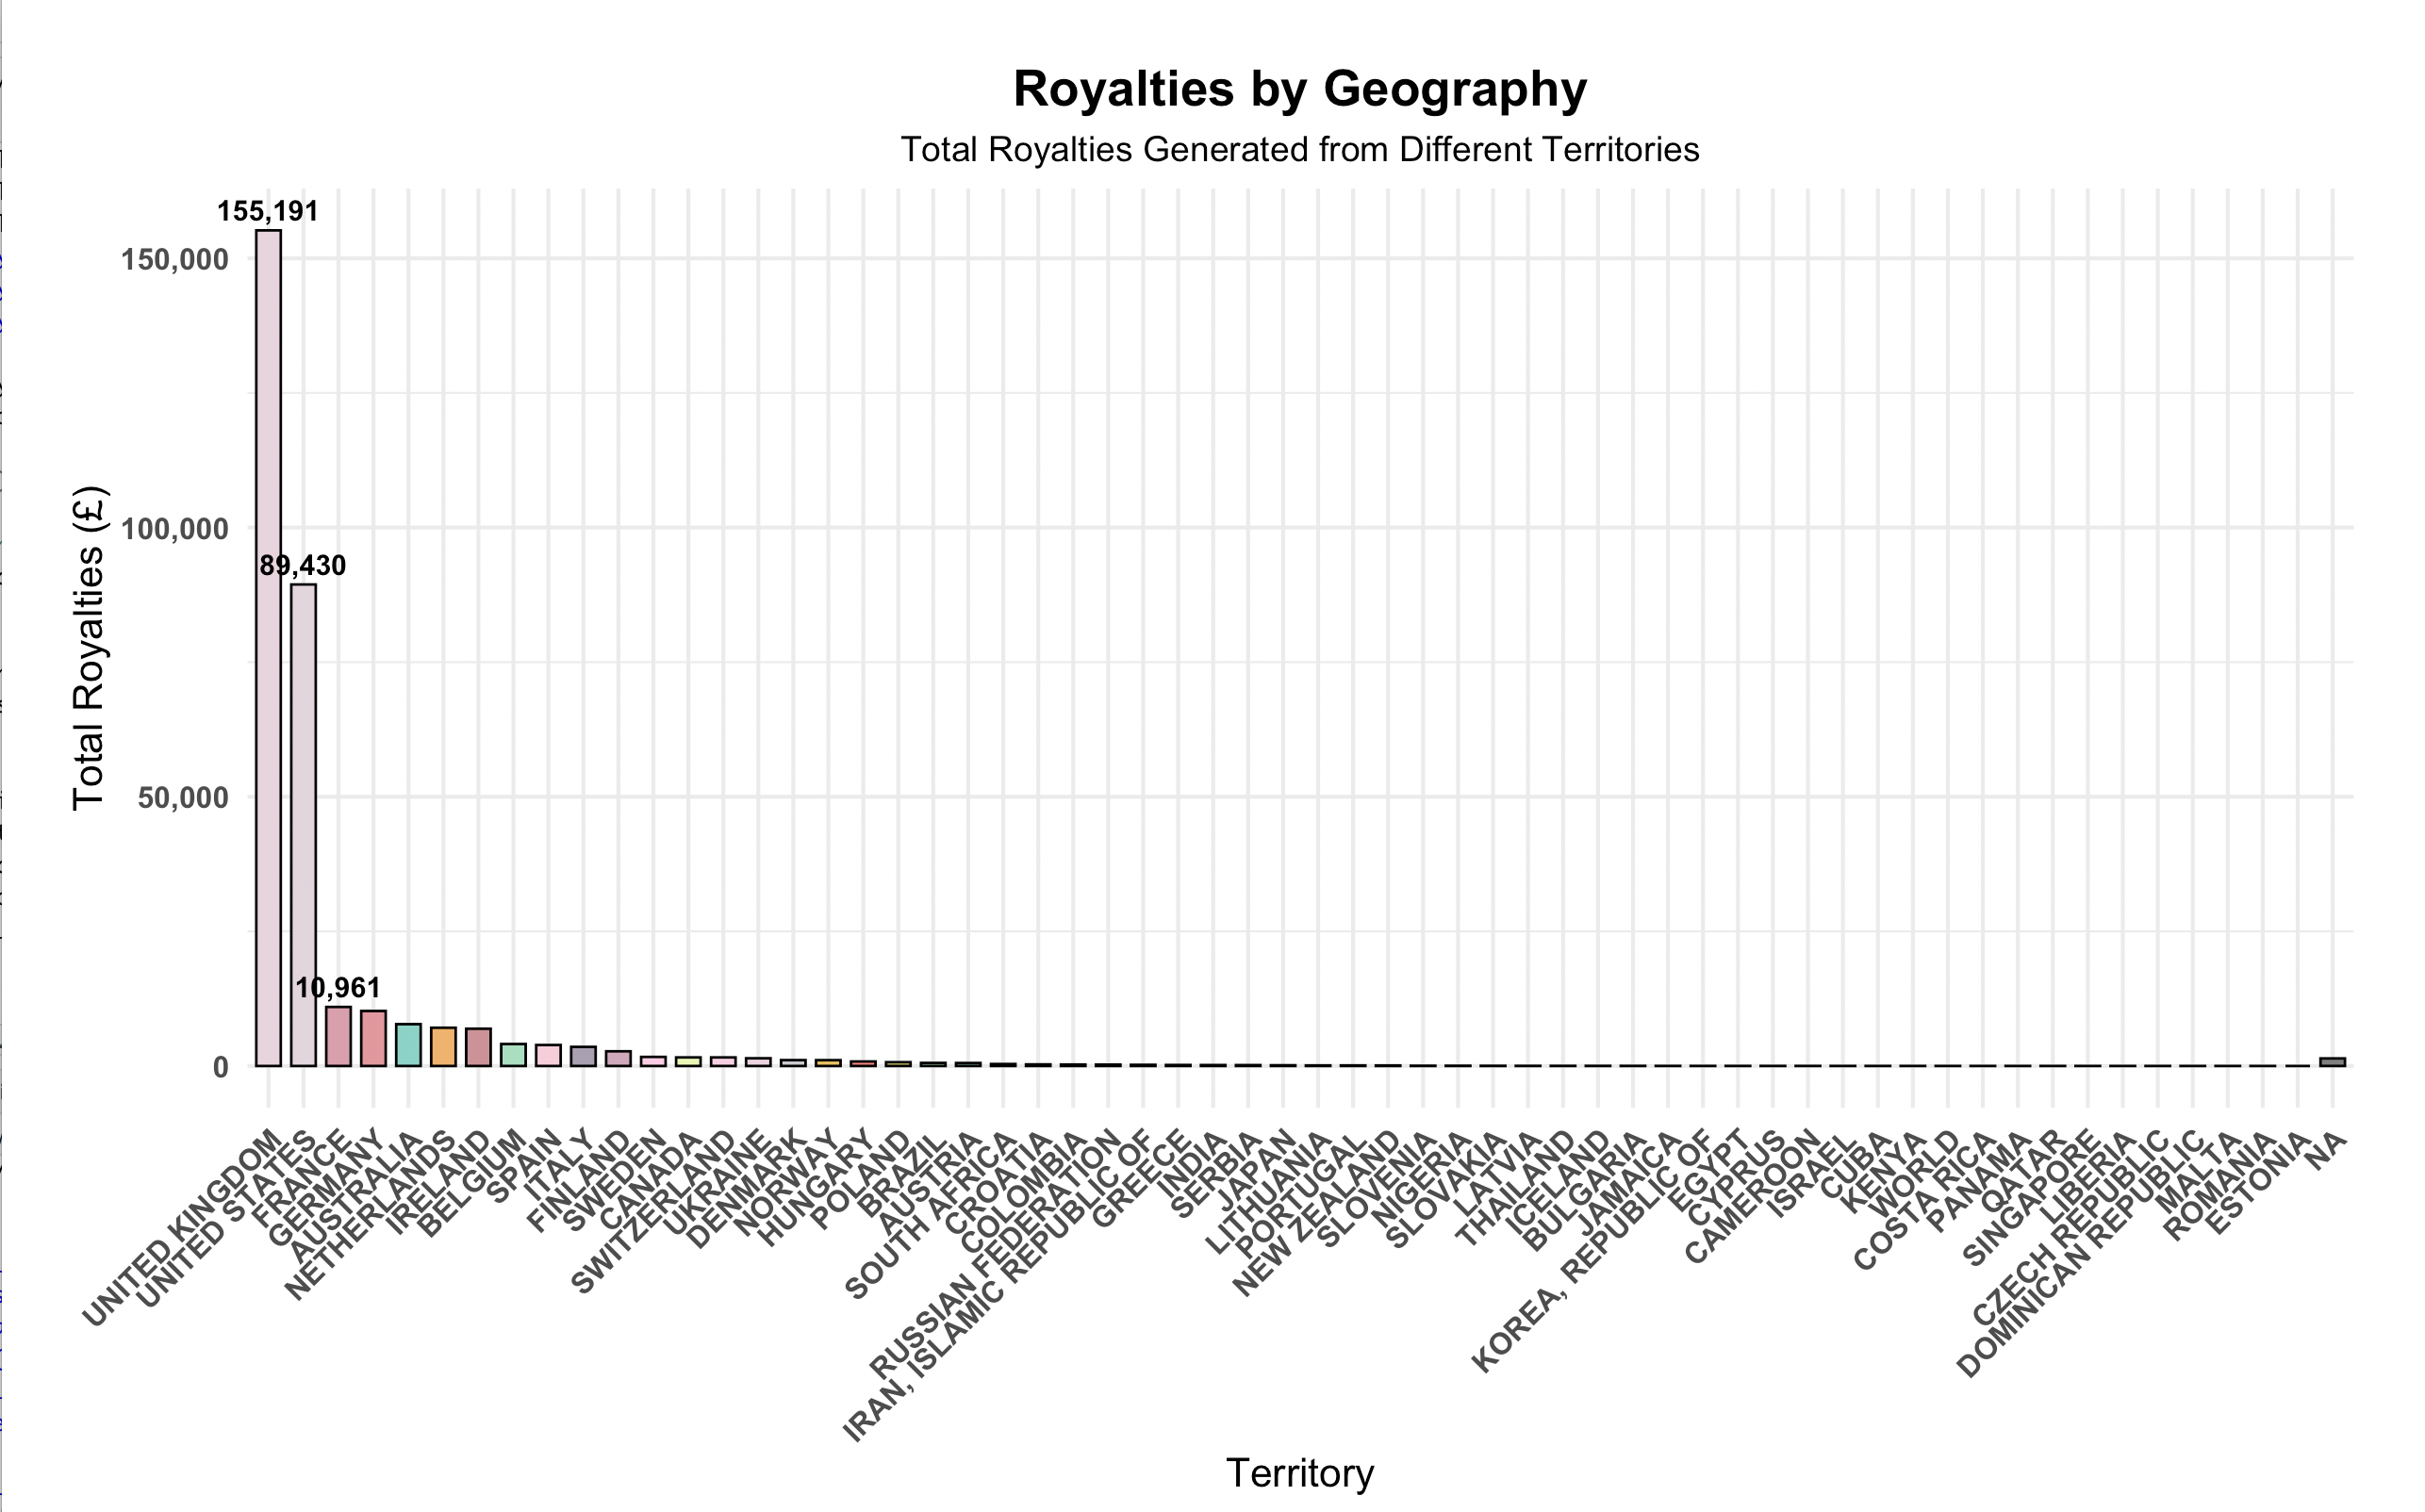
Geographical Analysis
Insight: UK and US are the largest sources of royalties, contributing the 77% revenue.
Insight: A small number of territories account for most of the revenue, while many other regions generate very little.
Recommendation:
Focus on growing in underperforming territories where there may be potential for higher return.
Expanding in France and Germany.
Conduct further analysis to understand why these markets are smaller
Adjust strategies accordingly
Evaluate the lower-performing regions.
Cost-benefit analysis to assess investing in growing those regions or focus on the top performers

Slide 6
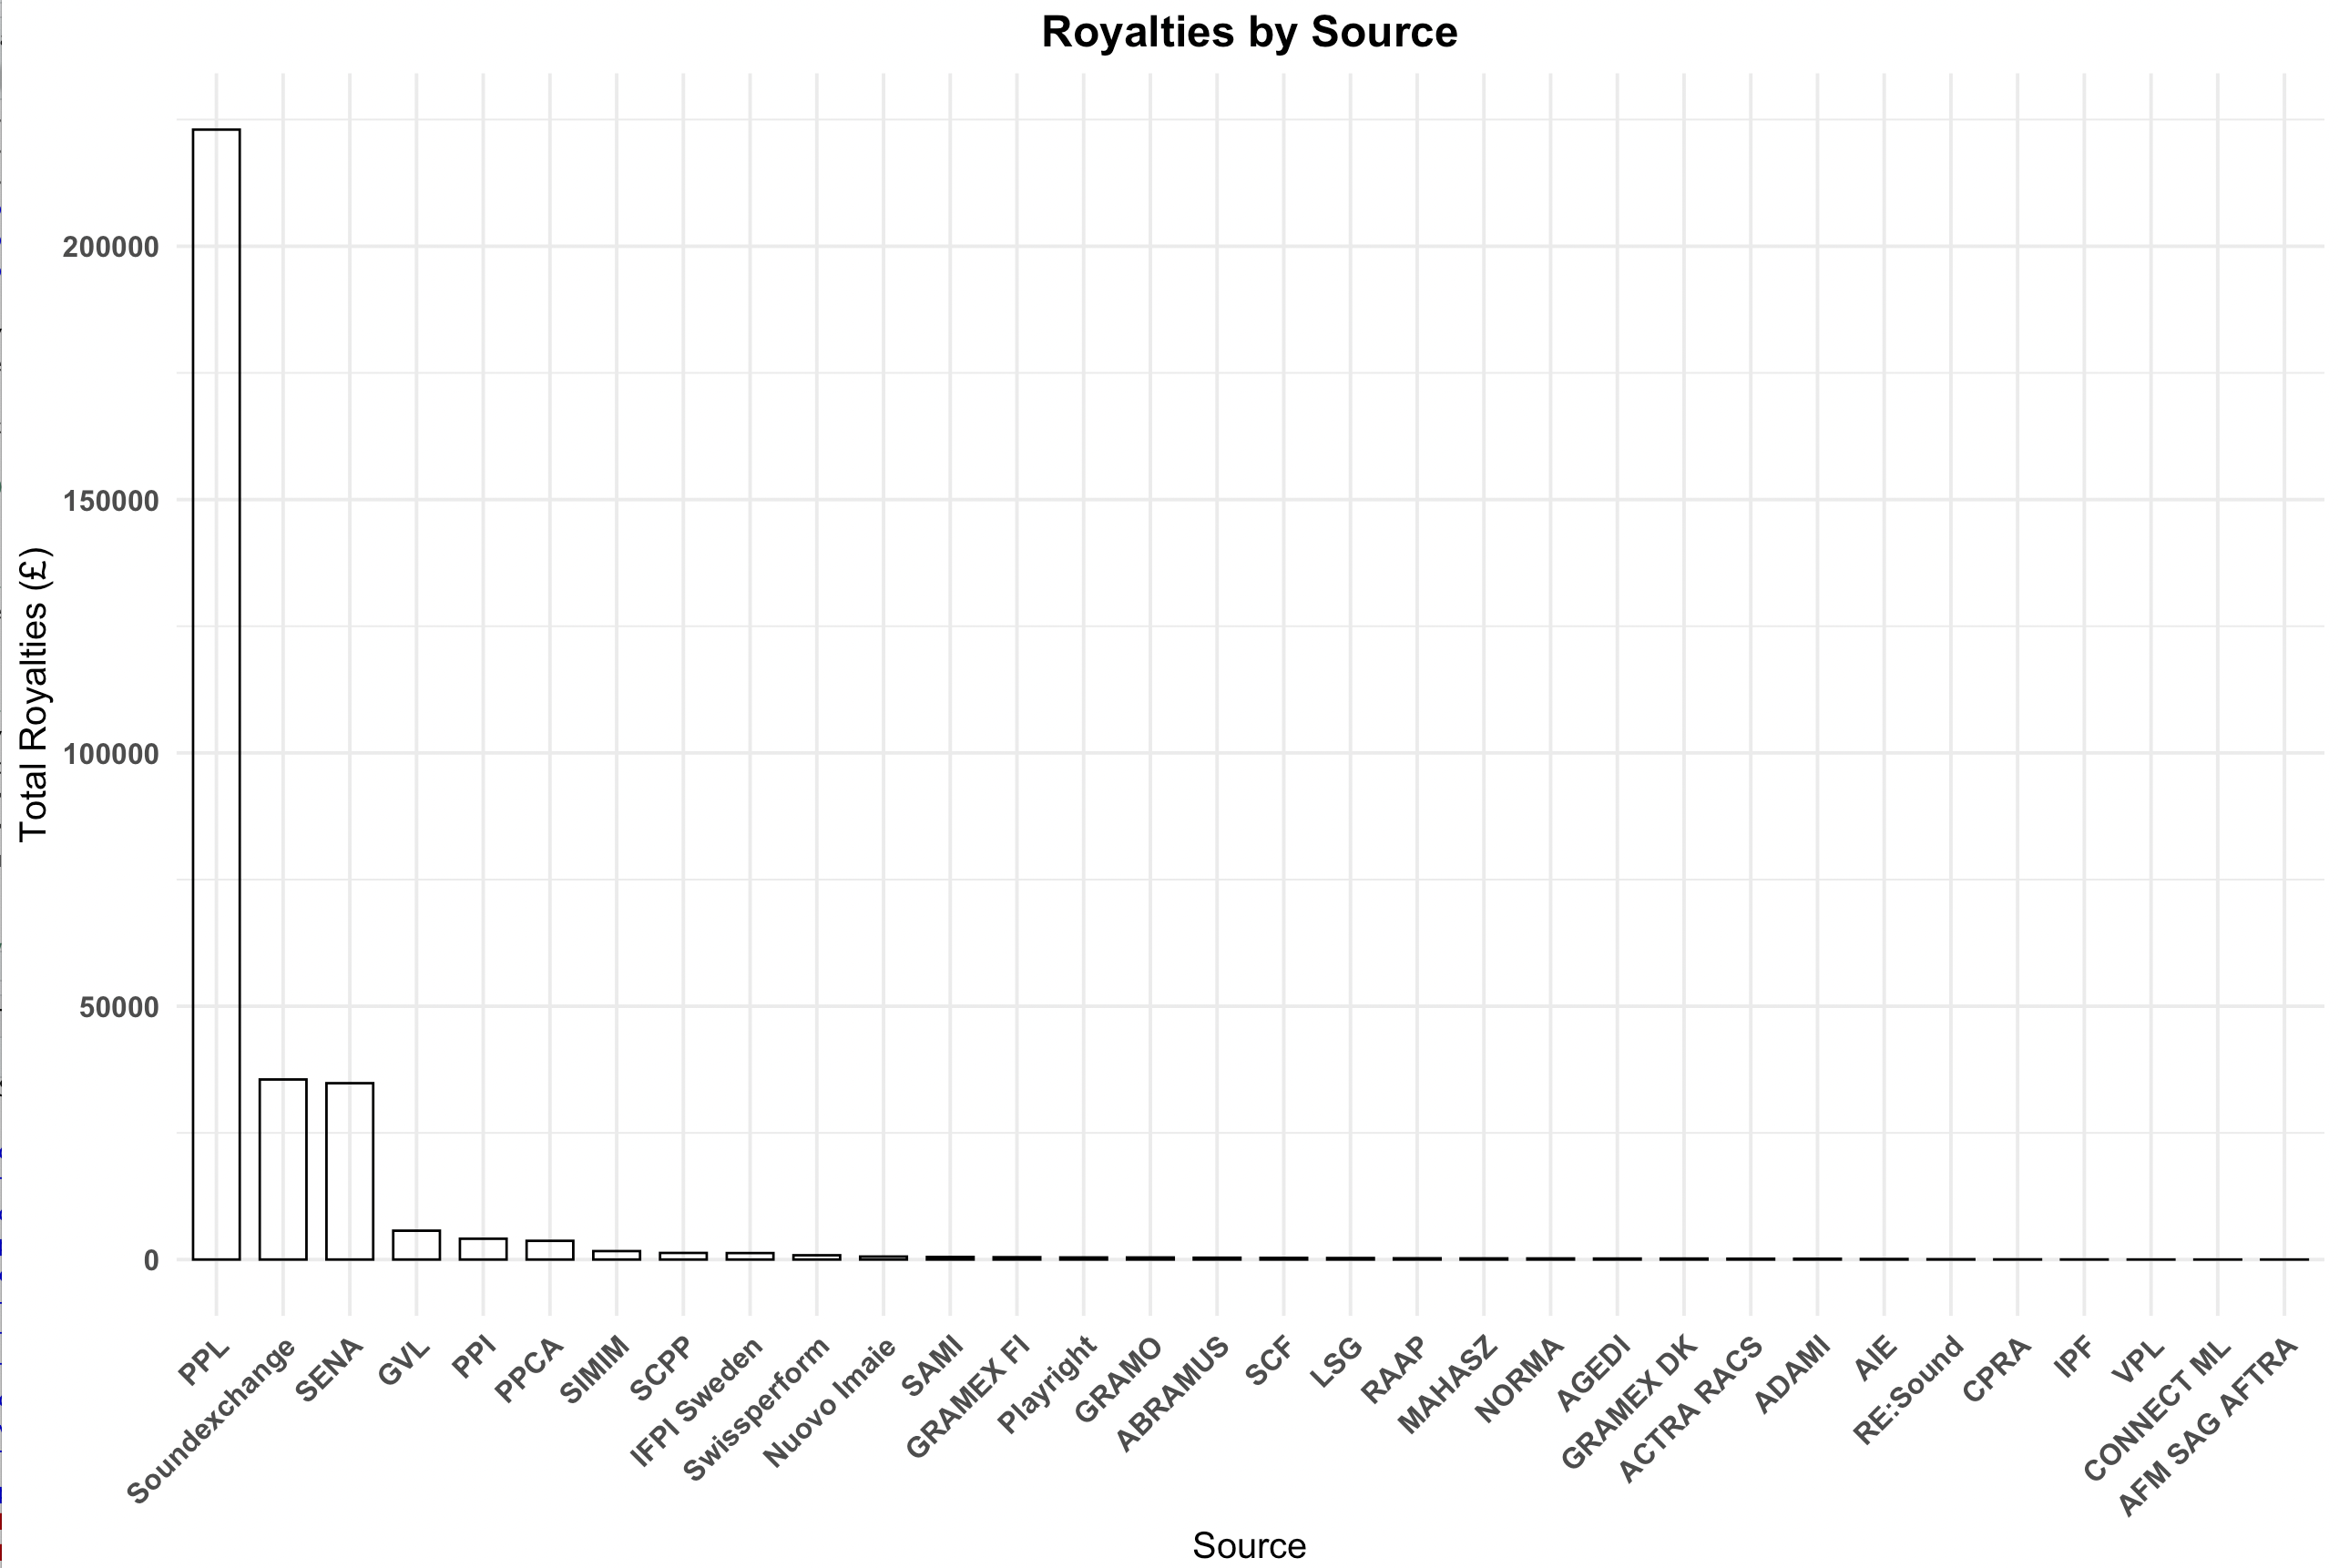
Royalty Source Analysis
Insight: Majority of royalties are generated from PPL.
Other sources: SoundExchange and SENA contribute smaller but still significant amounts.
Recommendation:
Investigate opportunities to expand revenue from sources that contribute less.
Diversifying income streams by growing underutilized platforms like SoundExchange could increase overall revenue.

Slide 7
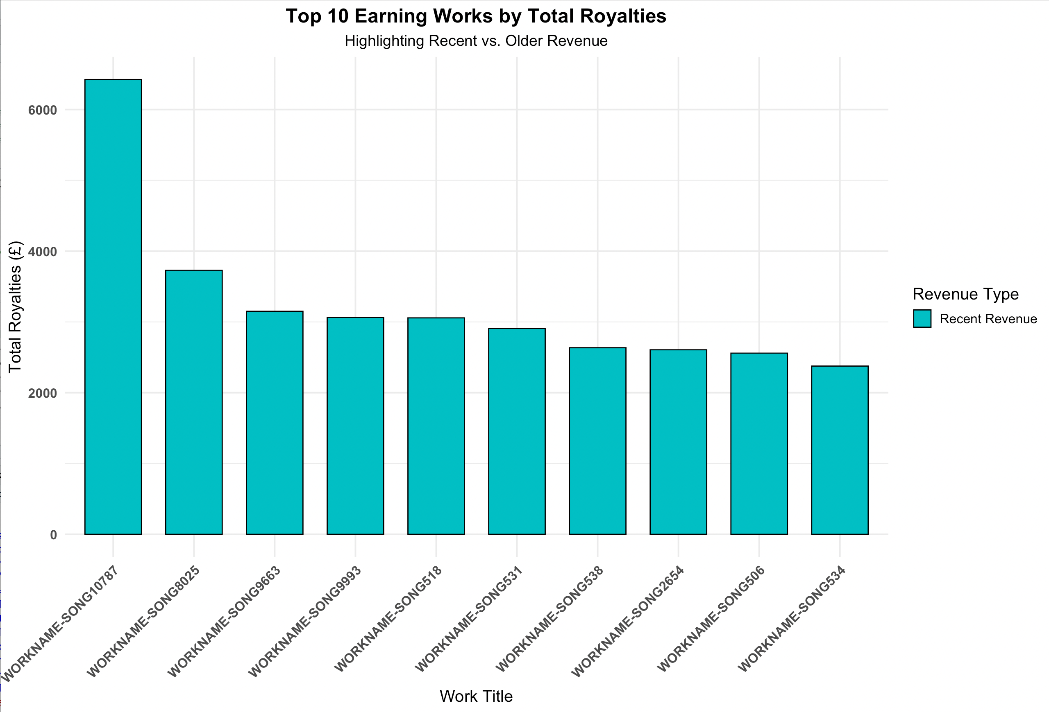
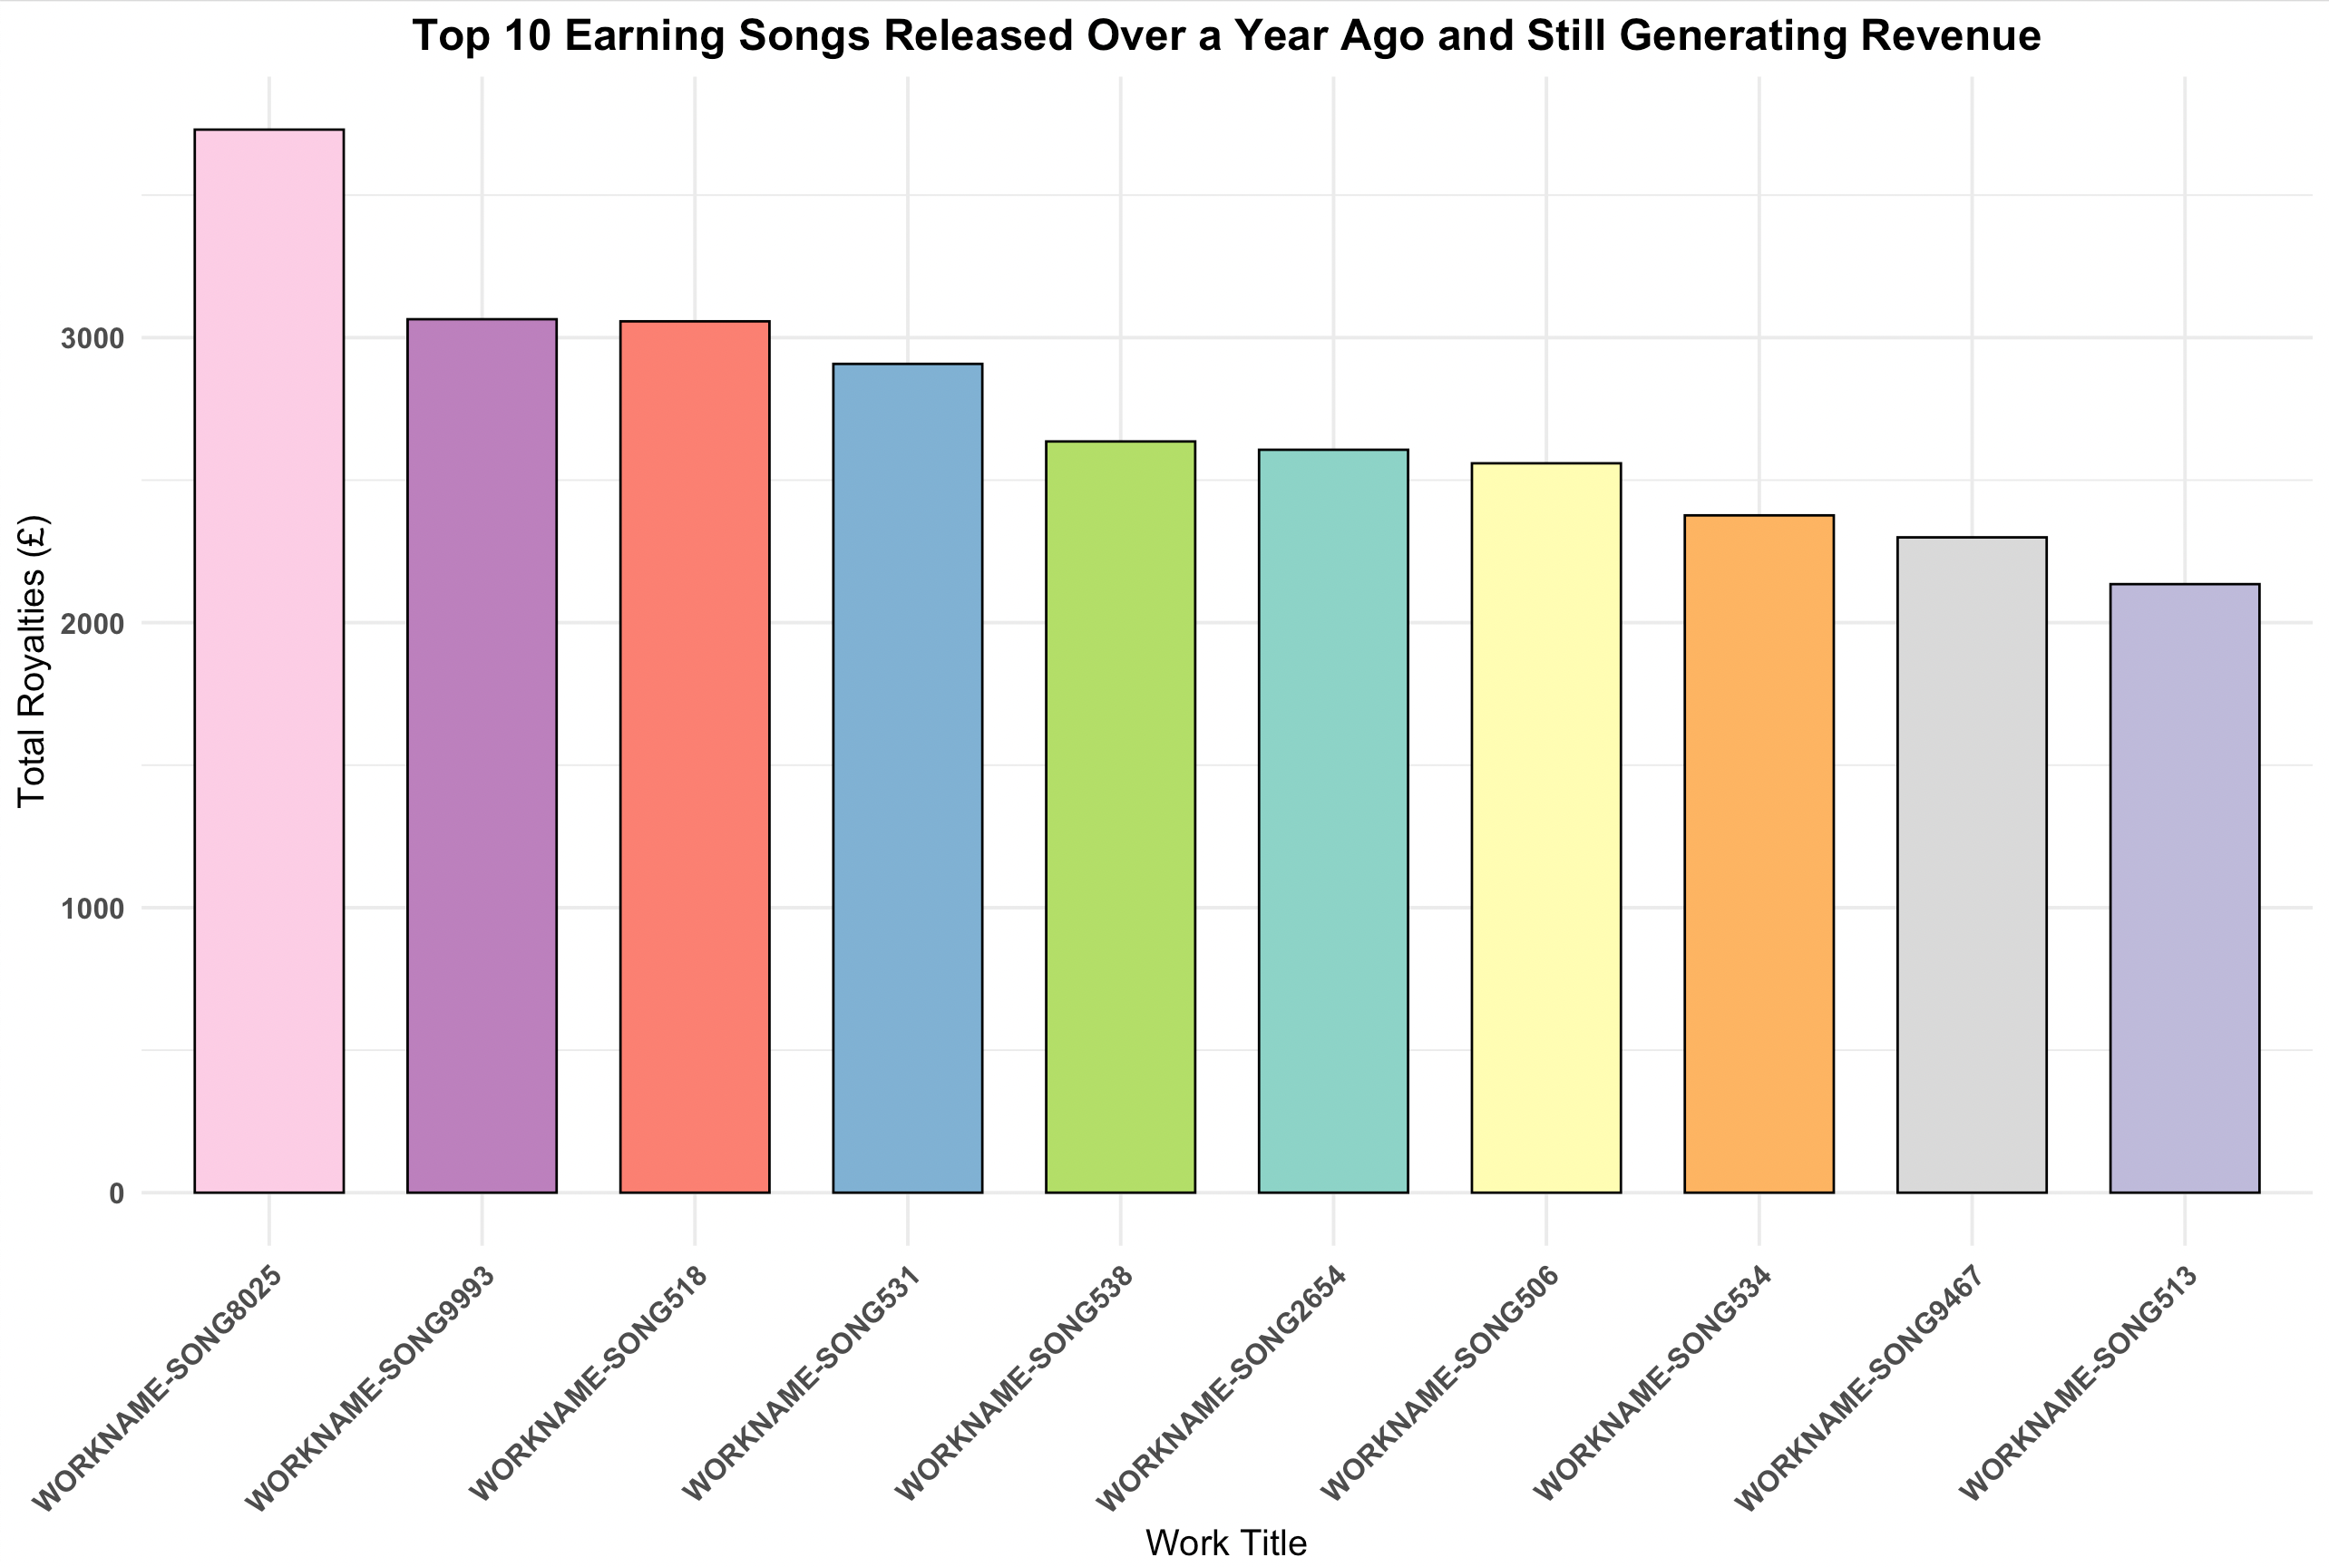
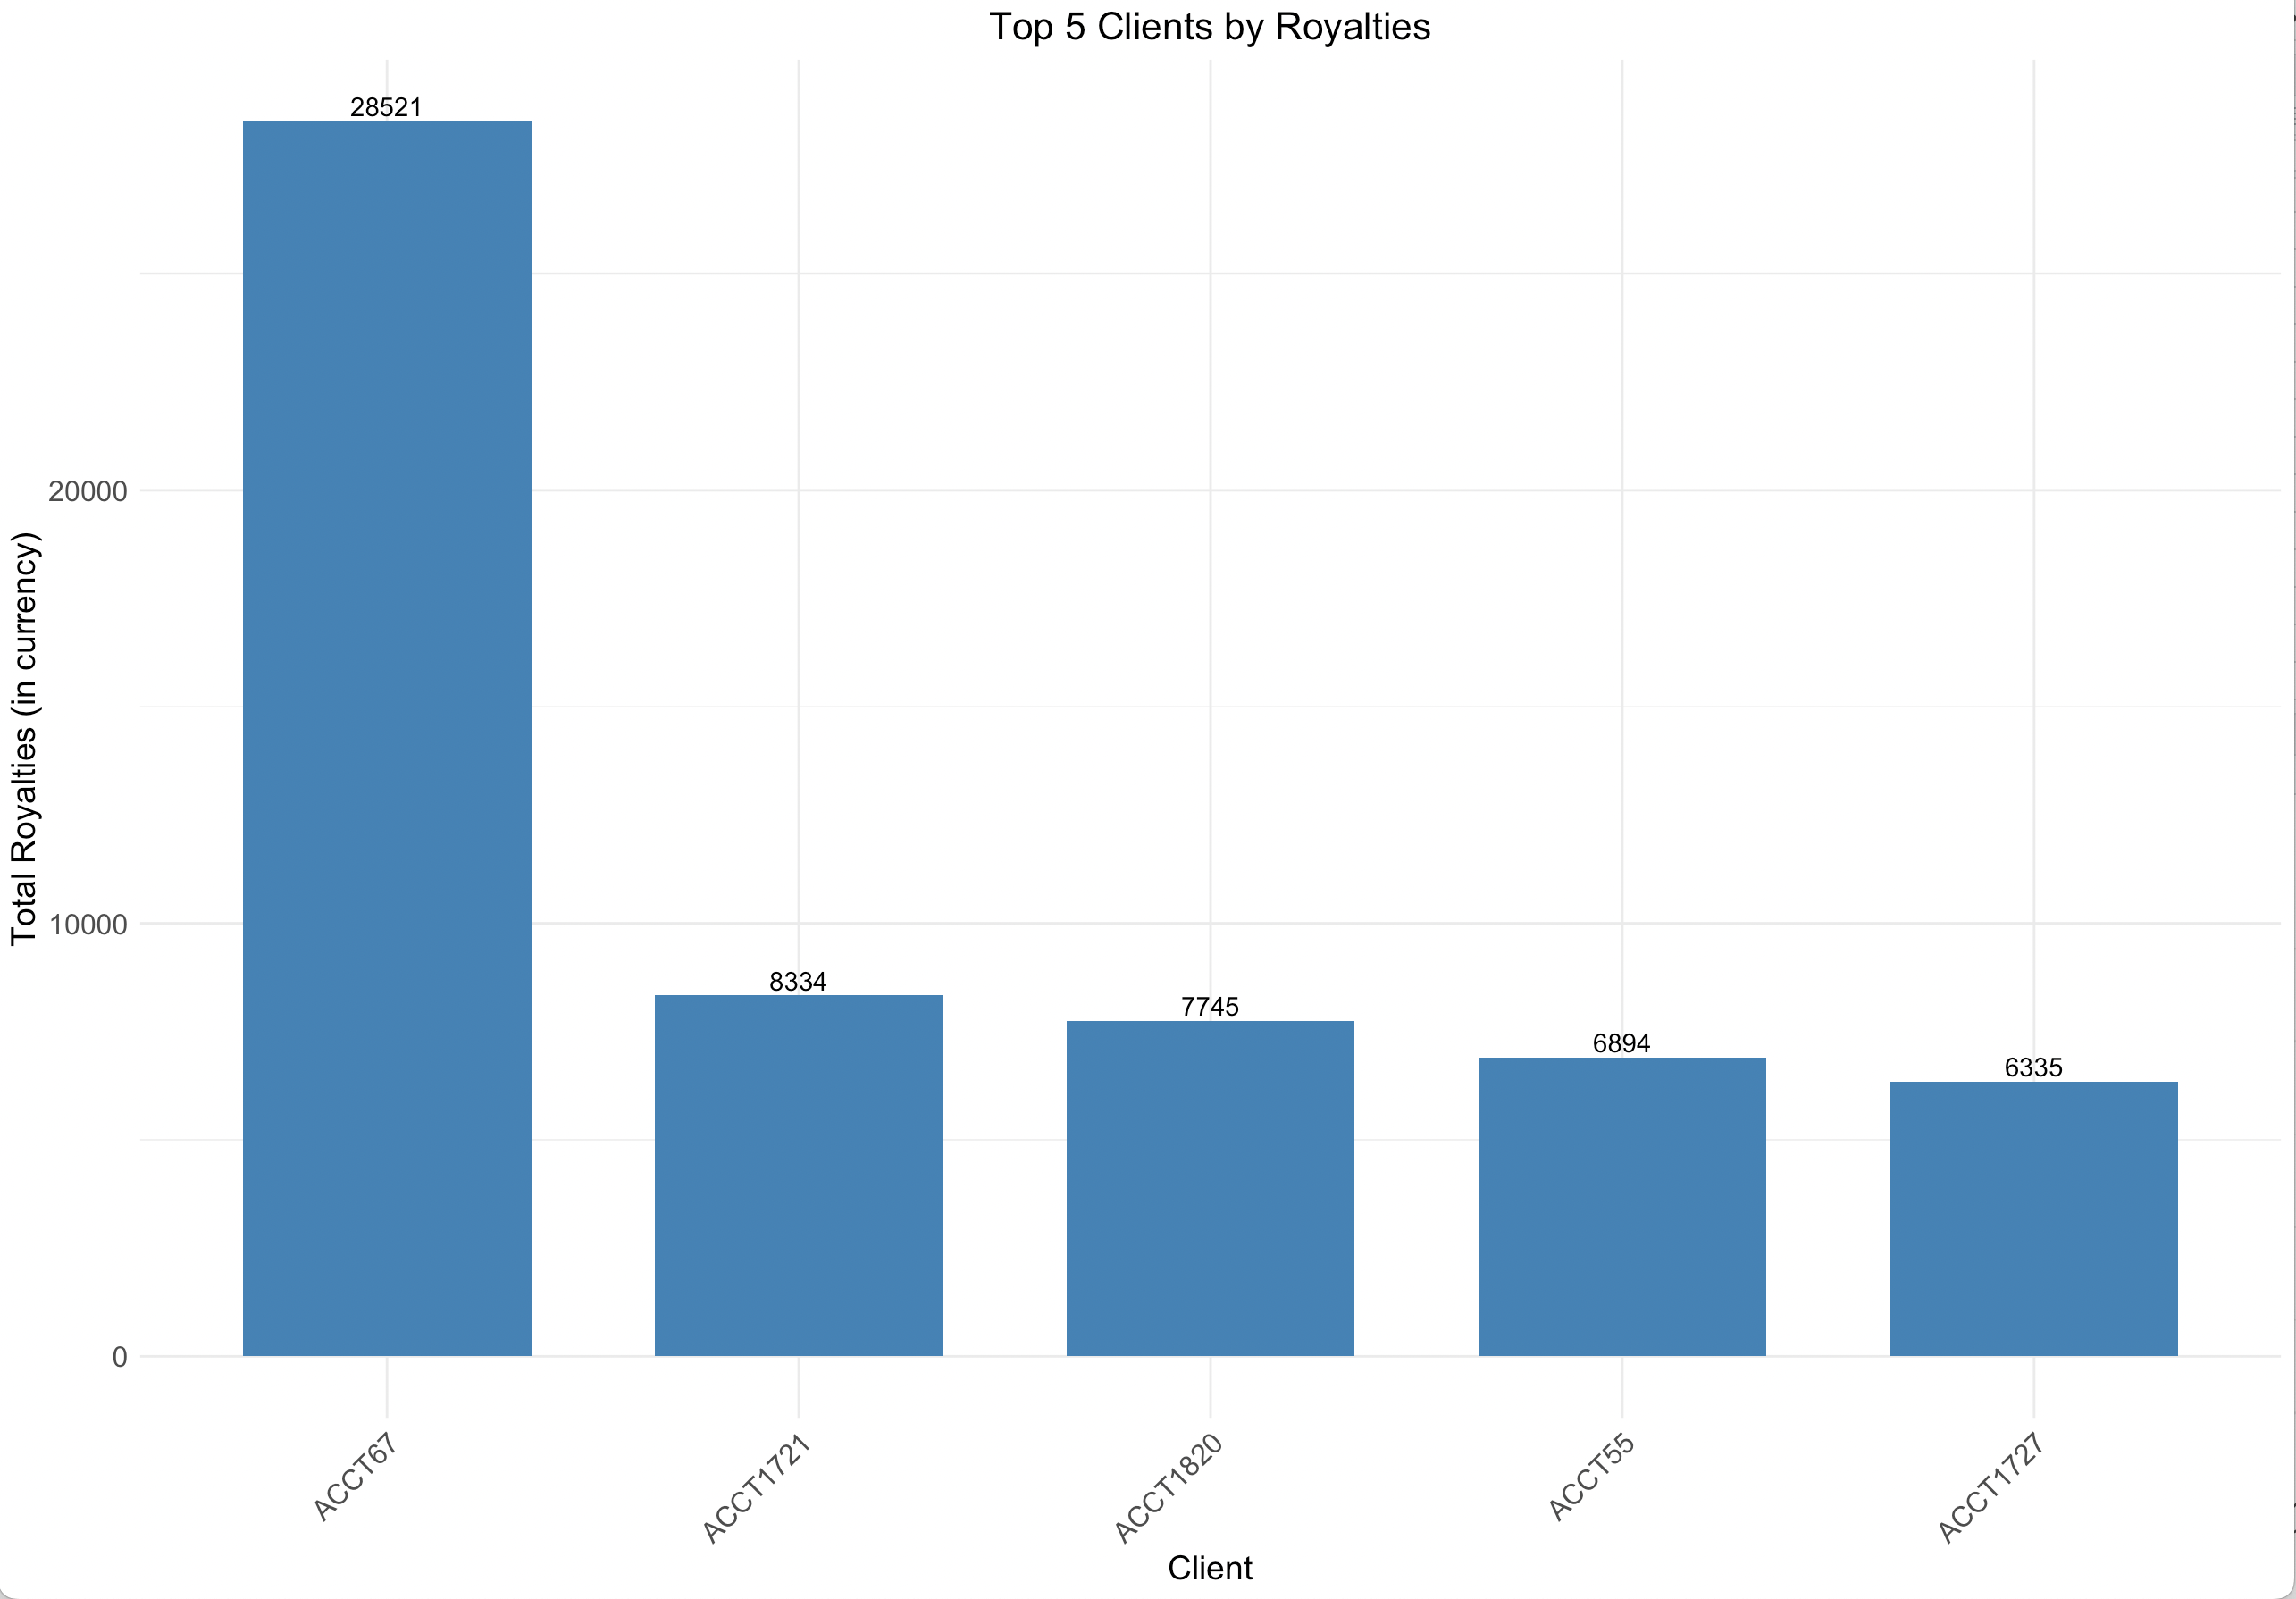
Top Clients and Works Analysis
Insight: A few clients generate the bulk of the revenue.
ACCT67 is a standout, contributing 9% of total, significantly more than other clients.
Insight: Some older works still generate substantial revenue, highlighting their long-term earning potential.
8/10 top earners were released over a year ago
Recommendation:
Prioritize relationship management with these top clients to ensure continued satisfaction and renewals.
Offer premium services or personalised support to maintain their contribution.
Songs with longevity should be continuously promoted, as they are proven revenue generators.
Consider if these can be featured in more playlists, compilations, or media channels.

Slide 8
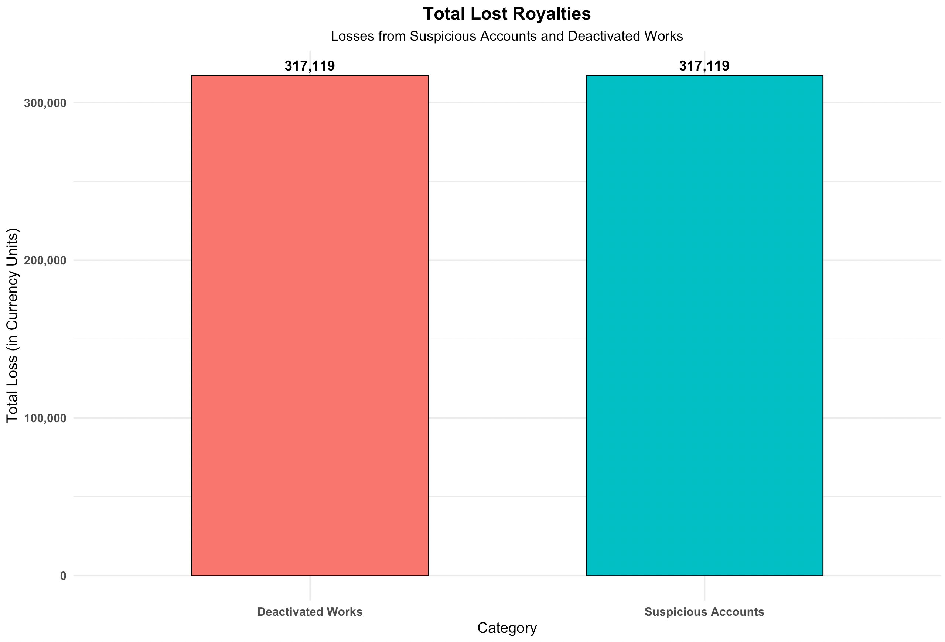
Risk and Losses Analysis
Insight: A substantial amount of royalties (£300,000+) has been lost due to deactivated works and suspicious accounts.
Recommendation:
Implement more stringent fraud detection and account monitoring practices to prevent further loss.
Review processes which classify deactivation to minimize legitimate earnings being classified as lost and not false positives.

Slide 9
Recommendations and Strategy
Grow top-performing regions:
Focus efforts on scaling growth in high-revenue territories like the UK and the US, but also explore new opportunities in regions like France and Germany.
Client tier focus:
Prioritize growth and retention strategies for Self Service clients, while exploring ways to increase the market share of Admin and Funded tiers.
Diversify sources:
Investigate additional revenue opportunities in underutilized royalty sources, focusing on platforms like SoundExchange or others with room for growth.
Tighten security and minimize loss:
Reduce royalty losses through enhanced account monitoring and improved fraud prevention.

